Slide 1
Lockheed Martin Snarfberry Pi
By Jhonatan Mendez

Slide 2
What is Bluesnarfing and why is it dangerous
Bluesnarfing is data theft between devices through a Bluetooth connection
This data consists of emails, texts, phone numbers, phone calls, network credentials, images, and so on.
Through MAC address spoofing, anyone could mistakenly connect to a malicious devices thinking it’s a peripheral device.
Once connection is established data will be stolen

Slide 3
Raspberry Pi Background
The Raspberry Pi is a low power consumption single board computer.
This yields in better customization on what one would want the Pi to perform thanks to the community and documentation provided by the Raspberry Pi foundation
In this case, the Pi acts as a low profile malicious device that is perfect for stealing device data with minimal detection, while causing a lot of damage

Slide 4
What is Snarfberry Pi?
Pure Bluetooth malicious attacks
This limits the need of SSH or a peripheral screen to interact with the pi
Exploitation will be carried out through Bluetooth commands and interactions between an Android device and a raspberry pi to steal information from other Bluetooth enabled devieces.
Thus the devices do not need to be connected to any Wifi networks or any peripherals for the attack to work.
Another benefit is that all this is completely automated. The pi is online and pairabled with the android device (or any device with a terminal) the user can detect other devices and conduct attacks.

Slide 5
Set Up and Automation
As previously demonstrated, environment set up can be done through Youtube videos and installing scripts from our github repository.
These attacks can be automated to see if the pi can be paired with one device, extract data, export the data to the android device, and move on to the next device.

Slide 6
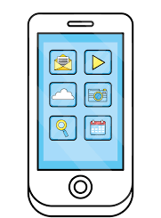



How Snarfberry Pi Will Work
The raspberry pi will detect devices and send their mac address and device name to the Android device.
The Pi will then steal data from a device and send the output to the android device
The android device will then tell the Pi what devices to Bluesnarf

Slide 7
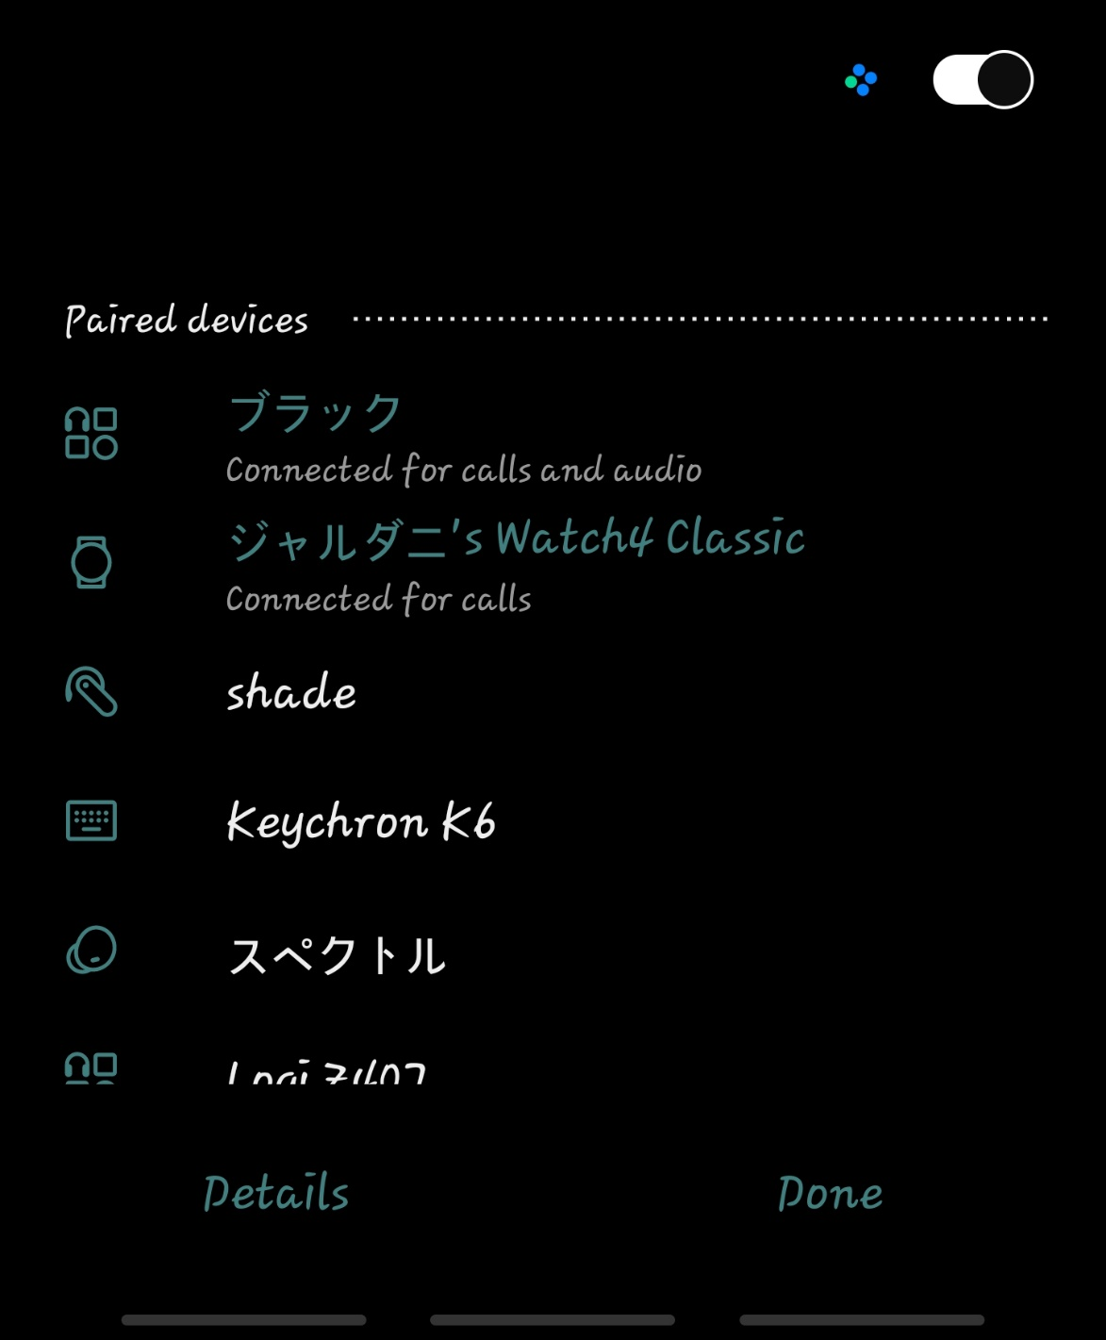
How It Works Continued
As previously mentioned, the Raspberry Pi is recognized as a Bluetooth headset
Anyone in the business setting could mistakenly connect to a device this like thinking its their headset. In addition, the host name and MAC address of the Pi can be changed to suit the device that Snarfberry wishes to imitate.

Slide 8
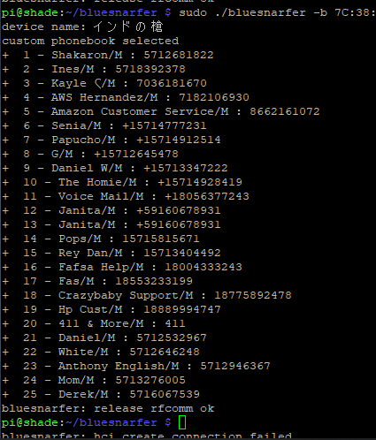
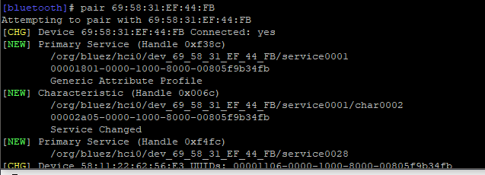

Current State of the Project

Slide 9
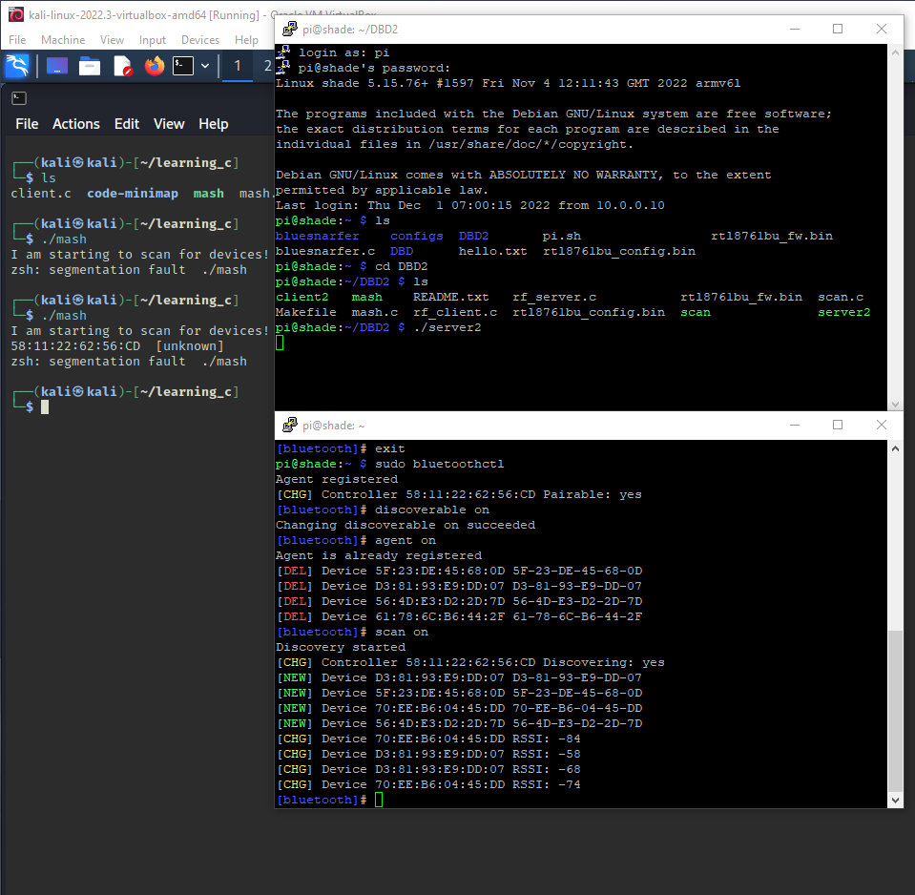
Current State of the Project

Slide 10
Future
I need more time with C to understand it better in hopes of branching out to other devices other than phones
Start to automate the process more
Establish better way to communicate with the android device and the raspberry pi
Test out this project with other devices other than a Raspberry Pi

